Slide 1
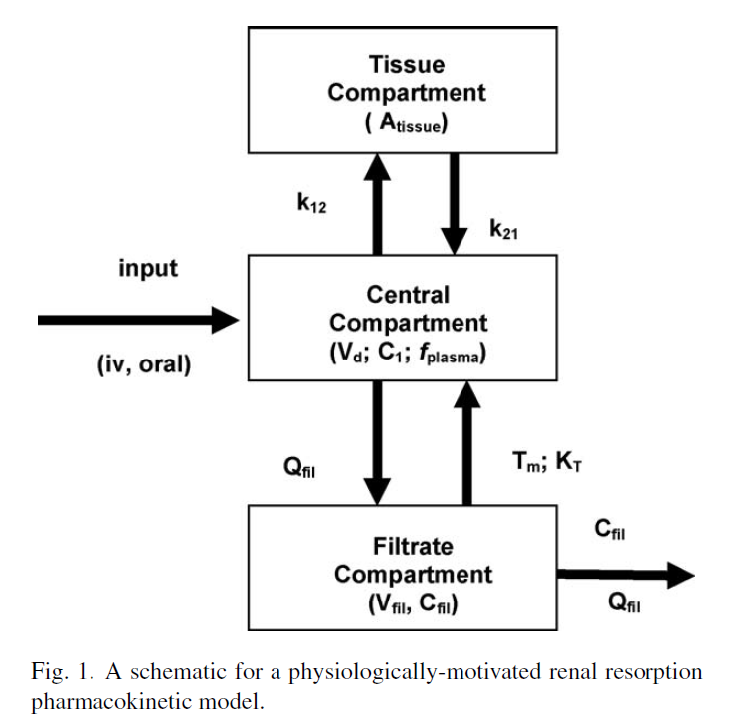
Key determinant of species and gender differences in PFOA half-life: Saturable renal resorption

Slide 2
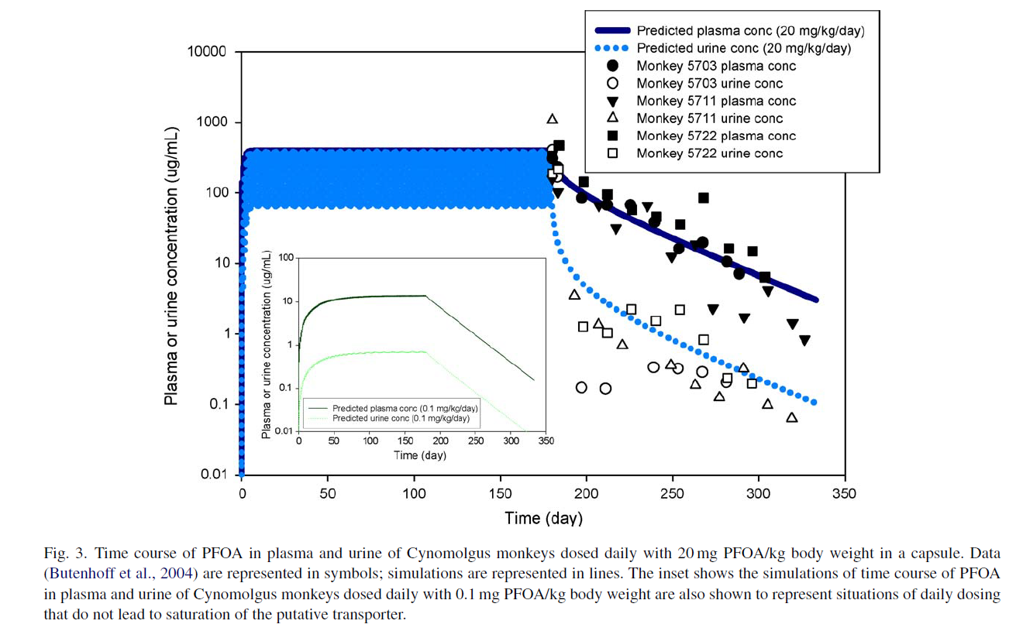
Saturation of resorption leads to more rapid clearance at high doses

Slide 3
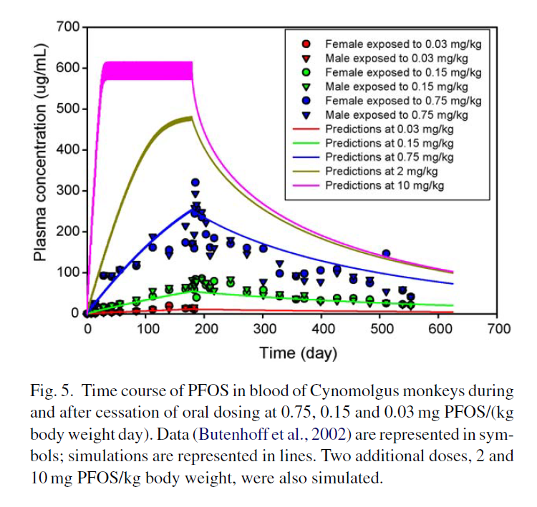
Saturation of resorption leads to nonlinearity at high doses

Slide 4
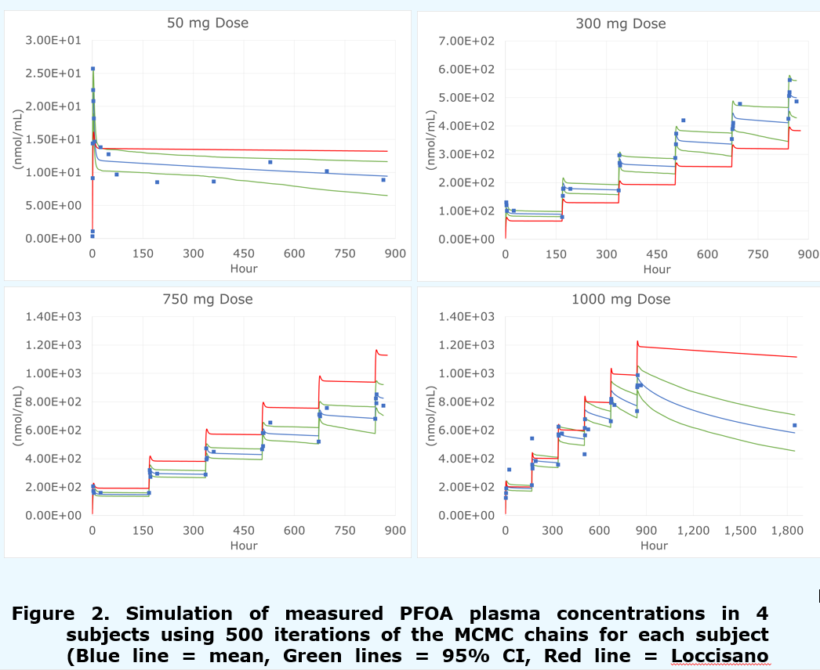
Preliminary MCMC Analysis of Elcombe Clinical Study
(Campbell et al. 2016)

Slide 5
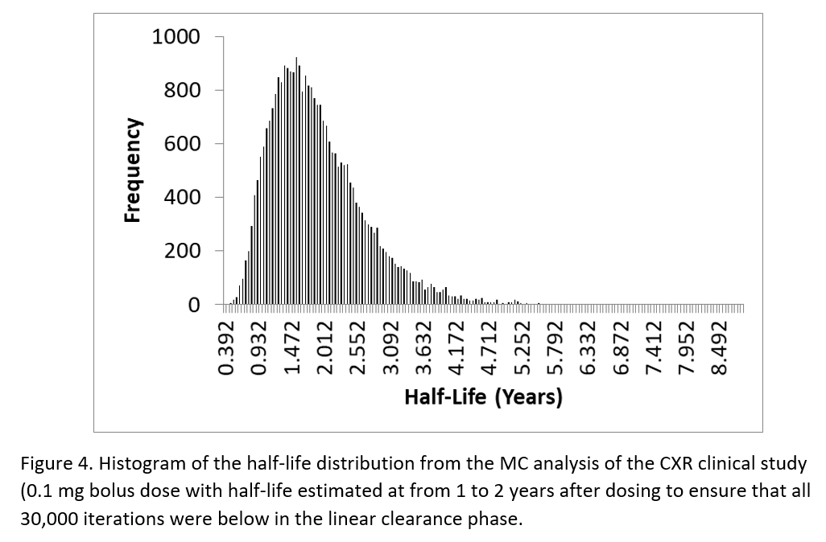
Final MCMC Analysis of Elcombe Clinical Study
PFOA Mean t_{1/2} = 1.8 yrs.
(Campbell et al. 2021, in preparation)

Slide 6
Recommendation
The CXR database provided a unique opportunity to incorporate a controlled human study in the calibration of the human PFOA PBPK model.
The clinical data were most useful in establishing the maximum rate and affinity constants for saturable resorption in the kidney which determine the half-life in humans.
Nevertheless, there is residual uncertainty in the half-life of PFOA in humans, as most of the participants in the CXR study were still above saturation of renal resorption upon termination of sampling.
Additional data from controlled exposures at lower doses would complement this study. PFOA blood concentrations should be determined in each subject prior to dosing.

Slide 7
A DDEF for PFOA
In the rodent, the half life of PFOA is on the order of 1-5 days and the duration of dosing in the developmental studies is long enough to reach pseudo-steady state
The human half life is on the order of 1.8 years and the exposures of concern are chronic (multigenerational), so they are at pseudo-steady state
Therefore, even in the case of developmental toxicity, the ratio of the daily doses that will result in the same blood concentration in the animal and human is the inverse of the ratio of the urinary clearance, which in turn is inversely related to the half-life (k_{e}=ln2/t_{1/2})
Thus, the interspecies pharmacokinetic adjustment is the just ratio of the half-lives
For PFOA, EF_{AK} ≈ 131 (657/5) to 657

Slide 8
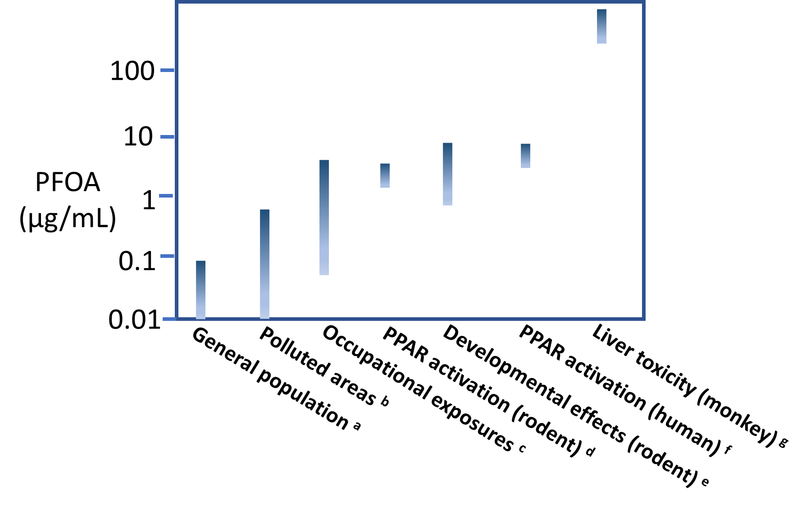
The real problem with risk assessments for PFOA: Failure to recognize a Dose-Dependent Transition Associated with Activation of PPAR
Exposures
Effects
Andersen et al. 2021 (submitted)

